Slide 1
Arrow of complexity
Big question: does evolution naturally tend to increase the complexity of evolved things?
For: life on earth is more complex now than it was originally (esp before life), and evolution is the only process capable of creating that complexity, so evolution manifestly has increased the complexity of evolved things.
Against: evolution by natural selection promotes proliferation of whatever proliferates/reproduces fastest – that’s all. Often the things that reproduce most effectively are not complex – e.g. parasites in Tierra, smaller loops in evoloop, bacteria/viruses on Earth. There is no inherent tendency for evolution to increase complexity, the observation that there are complex organisms on Earth is not sufficient to expect this to be a trend in evolution.

Slide 2
Overview
How to measure complexity?
Has complexity increased?
Is there a ‘generic trend’ for increase?
If yes, do we understand the mechanism?
What might be missing?
  Major transitions in evolution

Slide 3
How to measure complexity
What is it?
  Size, number of parts, amount of DNA?
Information theoretic concepts
  Entropy, randomness vs order
Kolmogorov complexity
Structural concepts
  Number of different parts, types of different parts, types of interactions

Slide 4
Information theoretic complexity: Shannon entropy
Information entropy (Shannon)= how much information there is in a signal (fair coin= 1 bit per toss, double-headed coin=0 bits per toss)
(2nd law of thermodynamics, spontaneous increase in entropy: order → disorder)
Totally predictable and ordered = low entropy
Totally random and unpredictable = high entropy

Slide 5
Kolmogorov complexity
The length of the shortest program (for universal Turing machine) that could generate it
Problems?
  Program to produce π is quite short, is π simple?
  Program to produce a long random number? (compare pseudo random number)

Slide 6
Problems with Kolmogorov and Entropy
Kolmogorov generally incomputable (As McShea puts it “what is the length of the shortest algorithm that will generate an actual rain forest?”)
Kolmogorov complexity maximised by randomness
Entropy maximised by randomness
Niether Kolmogorov complexity nor Shannon entropy maximise ‘pattern’ or ‘structure’ or ‘organisation’
(http://cse.ucdavis.edu/~cmg/compmech/tutorials//ComplexityMeasures.pdf)
Structural complexity
Totally ordered
entropy
Totally random

Slide 7
Modern approaches
Epsilon machines (Jim Crutchfield); state machines with probabilistic transitions
size of machine=complexity
Using probabilistic transitions (rather than deterministic), an e-machine that simulates random coin tosses is a small machine → low complexity
i.e. A random string is NOT complex in this measure
(finding minimal e-machine still incomputable though)

Slide 8
Less theoretic notions of complexity
e.g. structural complexity
Number of different parts; types of parts or interactions

Slide 9
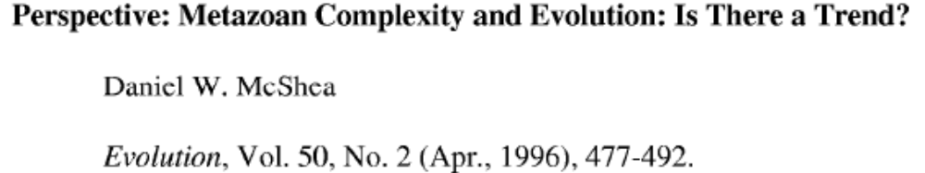
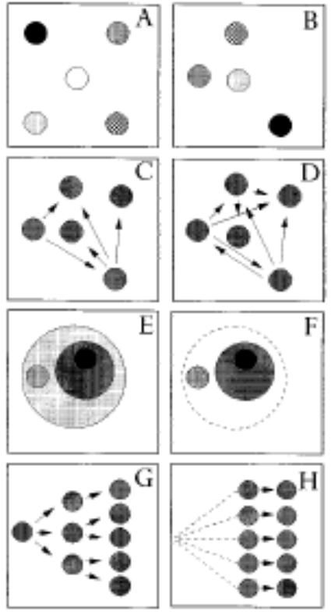
4 types of complexity, Mc Shea
Object vs process
Hierarchical vs non-hierarchical
(non-hierarchical) Object complexity
(non-hierarchical) Process complexity
Hierarchical object complexity
Hierarchical process complexity

Slide 10
Credit to
Mark Bedau, Reed College/protolife, for inspiration for this lecture
c.f. workshop talk (evolution of complexity workshop, organised by Carlos Gershensen and Tom Lenaerts) at Artificial Life X, Indiana, 2006.
And your third reading: "The Evolution of Complexity" , Mark Bedau, 2006. (you should have finished 4th reading, Dawkins, by now – ‘Why are genes selfish?’)

Slide 11
Has complexity of life on earth increased?
Consider: Non-living molecules, replicating molecules, protocells, simple (prokaryote) cells/bacteria, eukaryotic cells, multicellularity, large complicated multi-cellular organisms with brains and language
But there’s still an awful lot of bacteria (by species, by biomass, by diversity)
Certainly the complexity of the most complex thing has increased, and probably the mean complexity has increased too, but its not clear this is the question you really meant to ask…
For example, would you be satisfied if this was a result of ‘passive diffusion’ (increase in complexity not adaptive)?

Slide 12
Trends
Trend: An observable increase or decrease in a measured quantity
Generic trend: robust regularity in trend (repeatable, like a ‘law’, not accidental)
Mechanism: explains a generic trend
E.g. stocks:
  Trends: ‘black Monday 1987’ stable trend becomes rapid falling trend
  Generic trends: boom and crash cycle happens repeatedly/ is bound to happen
  Mechanism: positive feedback in trading price increases creates artificially inflated prices with no ‘real’ value underlying them …

Slide 13
Example 2: complexity of life on Earth
  Trend: complexity of life on earth has increased
  Generic trend?: could be
  Mechanism: Evolution, IFF complexity was adaptive
But, we don’t know if the trend in increasing complexity is a generic trend (we only have one sample). And we don’t know if evolution is the/a sufficient mechanism. Because we don’t know that complexity is adaptive!

Slide 14
Some opinions
Darwin: “from [evolution by natural selection] the production of higher animals directly follows”
Dennett: complexity increase is “forced move”
Stephen Jay Gould: its all ‘historical contingency’ (accidental) – passive diffusion (McShea 1994) at most
John Maynard Smith: no expectation of increased complexity from natural selection
Stuart Kauffman: there is a generic trend, but the mechanism is self-organisation
Mark Bedau: this is all rhetoric, if you think you know a mechanism, show me the model that exhibits the generic trend. We havn’t seen one yet!

Slide 15
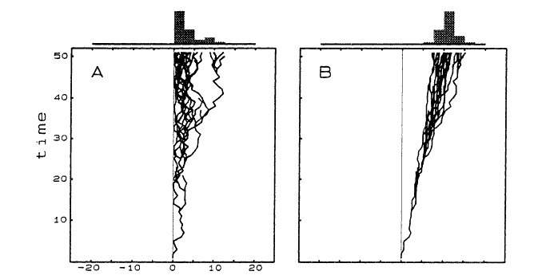
Passive diffusion model, McShea 1994
passive
driven
The problem is, is that x-axis a reasonable dimension?
consider ‘number of wheels’ or ‘number of pink stripes’.
This model doesn’t actually produce anything complex

Slide 16
Bedau on Tierra
For example, maybe you think the following properties are sufficient for a system to show generic trend to increasing complexity
  natural selection
  implicit fitness
  infinite genetic space
  computational universality
Tierra has all these things, but the results do not exhibit generic trend to increasing complexity.
If Ray didn’t implement these things ‘correctly’ in Tierra, then our definition of these features is incomplete

Slide 17
Some extra magic ingredient?
Hierarchical structure
The major transitions in evolution, Maynard Smith and Szathmary
  Self-replicating molecules → chromosomes
  Proto-cells → cells
  Prokaryote cells → Eukaryote cells
  Single celled organisms → multicellular organisms
  Asexual populations → sexual populations
  Homogeneous populations → eusocial colonies
“entities that were capable of independent replication before the transition can replicate only as part of a larger whole after the transition”

Slide 18
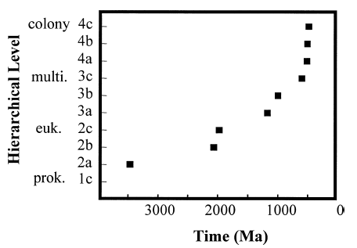
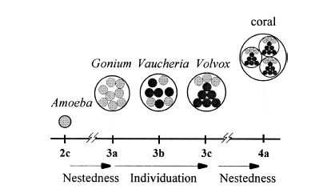
Hierarchical Evolution, McShea and Changizi, 2003
Hierarchical composition
degree of individuation
a) monomorphic aggregate,
b) differentiated aggregate,
c) (b)+intermediate level parts
NB. The paper is actually about some problems in this apparently neat trend

Slide 19
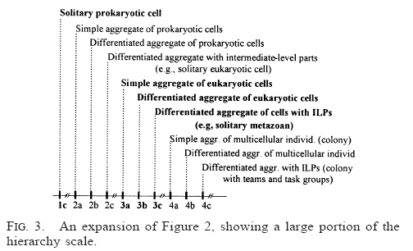
Some more detail
NB. The paper is actually about some problems in this apparently neat trend

Slide 20
Hierarchical evolution
It’s an enticing observation about natural evolution
Maybe it is a generic trend
Im not convinced that evolution by natural selection is a sufficient mechanism
In any case,
  Standard model of EAs doesn’t support this kind of hierarchical organisation
  No-one has demonstrated generic trend for hierarchical complexity in an evolutionary model/Alife model

Slide 21
‘odious allies’
Evolution by natural selection explains some adaptedness of organisms,
But “dishonest to deny that evolutionary creativity is an open question, a mystery.” Bedau.
Evolutionary creativity is an open question ≠ supernatural explanation required.
If increase in complexity is a generic trend, what is the mechanism that produces it? If it is evolution by natural selection (which is surely involved), what is missing from current artificial examples?
What are the mechanisms that are missing in our understanding? (e.g. rich physical environment, coevolution, self-organisation, dynamical systems theory, mechanisms of encapsulation, hierarchy, changes in the unit of selection)

Slide 22
Summary questions
Measuring complexity isnt easy:
  why isnt Kolmogorov complexity wholly satisfying as a measure of complexity?
  Where will something with pattern or structural complexity be on the entropy scale of complexity?
Does McShea’s passive diffusion model exhibit a generic trend for increase in complexity?
  Does that prove complexity will increase in nature?
“Evolution by natural selection is a sufficient mechanism for driven increase in complexity” – true or false?
(Hierarchical complexity is interesting
  We don’t know how to do it)

